Slide 1

Infosys Springboard Internship 5.0
Project Name- Voice Based Patient Call System
Mentor:-Shilpie Ma’am
Details of the Presenter
Name: Shubh Gupta
Batch:B-3
Date: 05 Feb 2025

Slide 2


Problem Statement
Current Challenge
Solution
Traditional patient call systems often lead to delays, missed requests, and poor communication.
A voice-based patient call system can improve patient engagement and communication, leading to better healthcare outcomes and dynamically prioritizes patient's need with multilingual support.

Slide 3


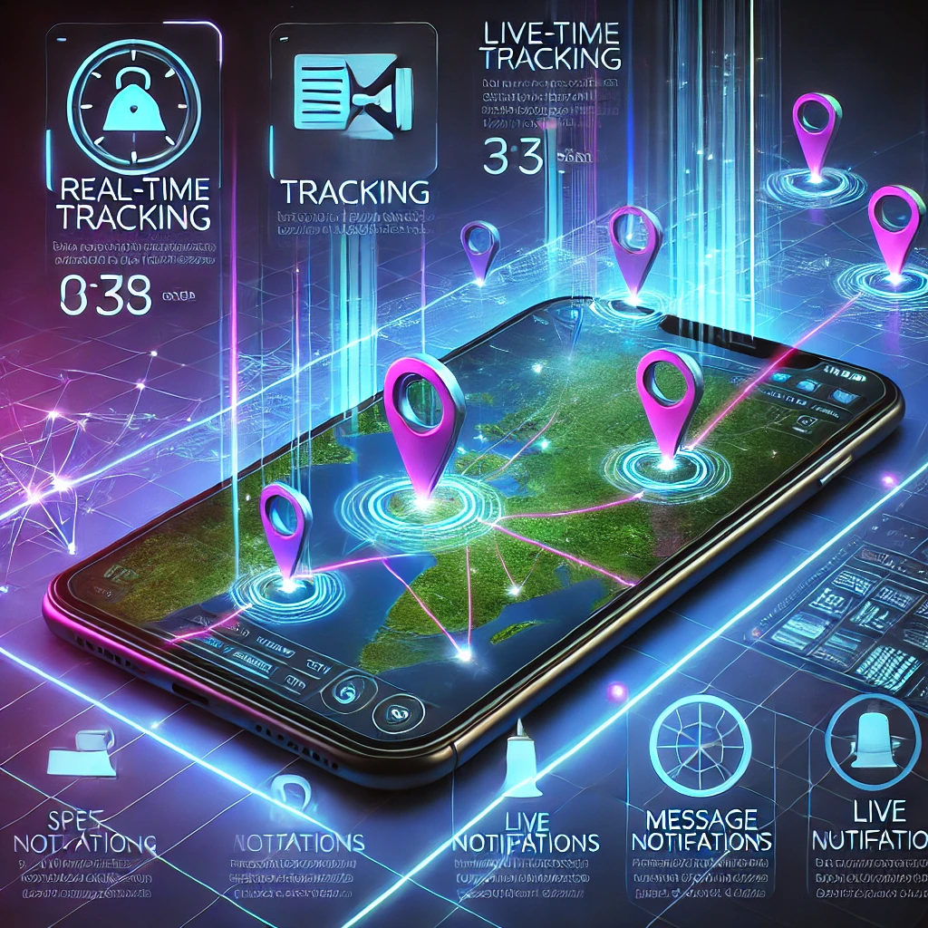
Objectives
Fast Communication Channel
AI-Powered Prioritization
Real-time Tracking and Notifications
A robust communication infrastructure for real-time interaction between patients and healthcare providers.
Utilizing AI algorithms to analyze patient data and dynamically prioritize their needs.
Enables healthcare providers to monitor patient status and receive timely alerts for critical situations.

Slide 4






Technology Stack
Expo React Native for Frontend
Node.js and Express for API and Server Logic
MongoDB for data Storage
TensorFlow.js
Azure for Speech Services
Android Studio

Slide 5
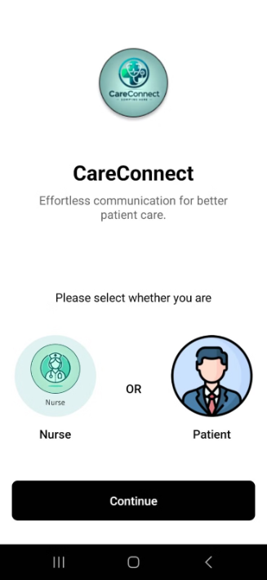
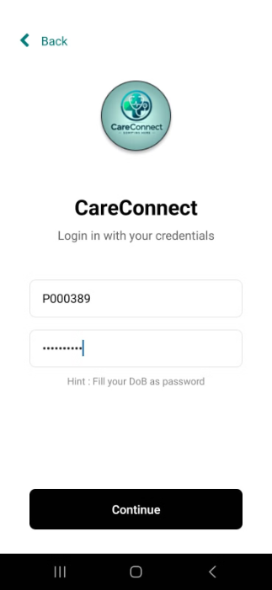
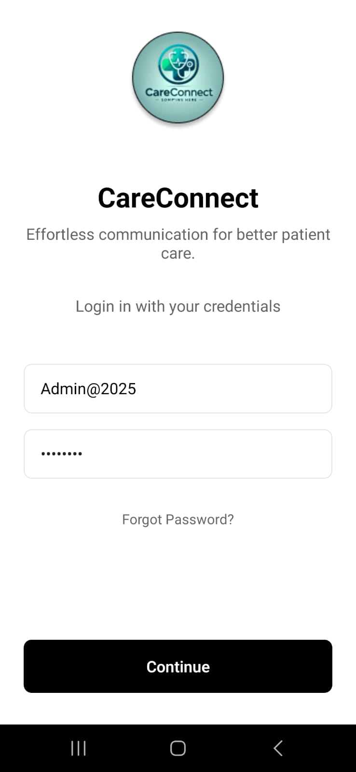
App Interface

Slide 6
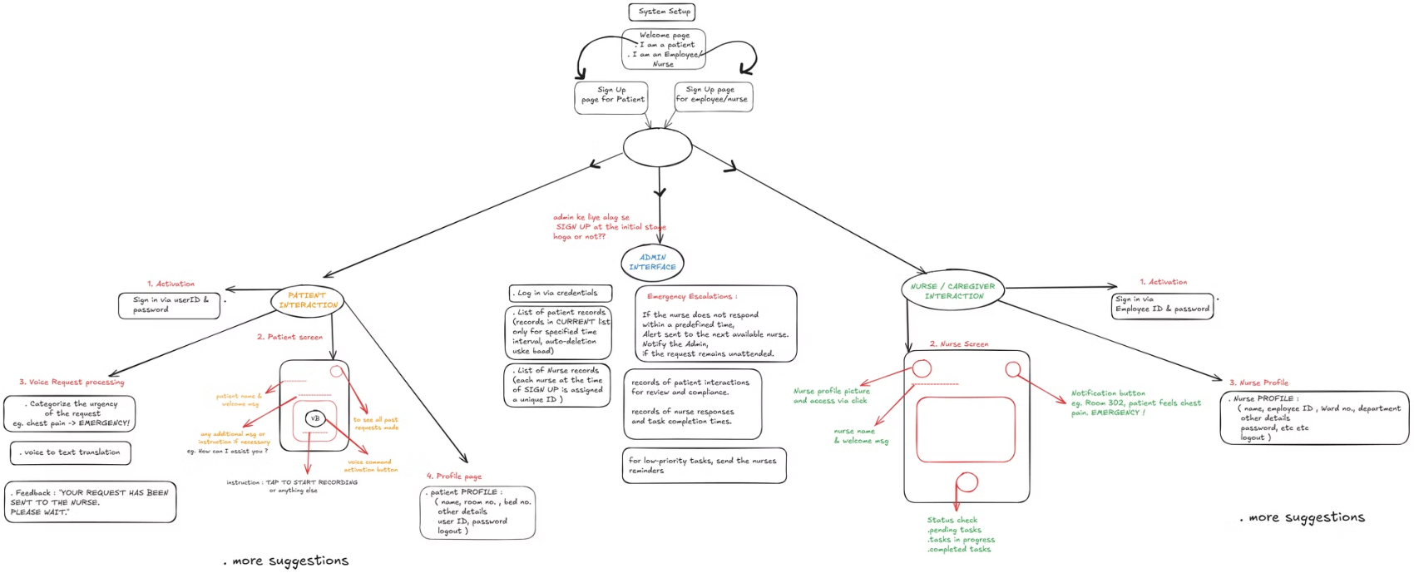
FlowChart

Slide 7
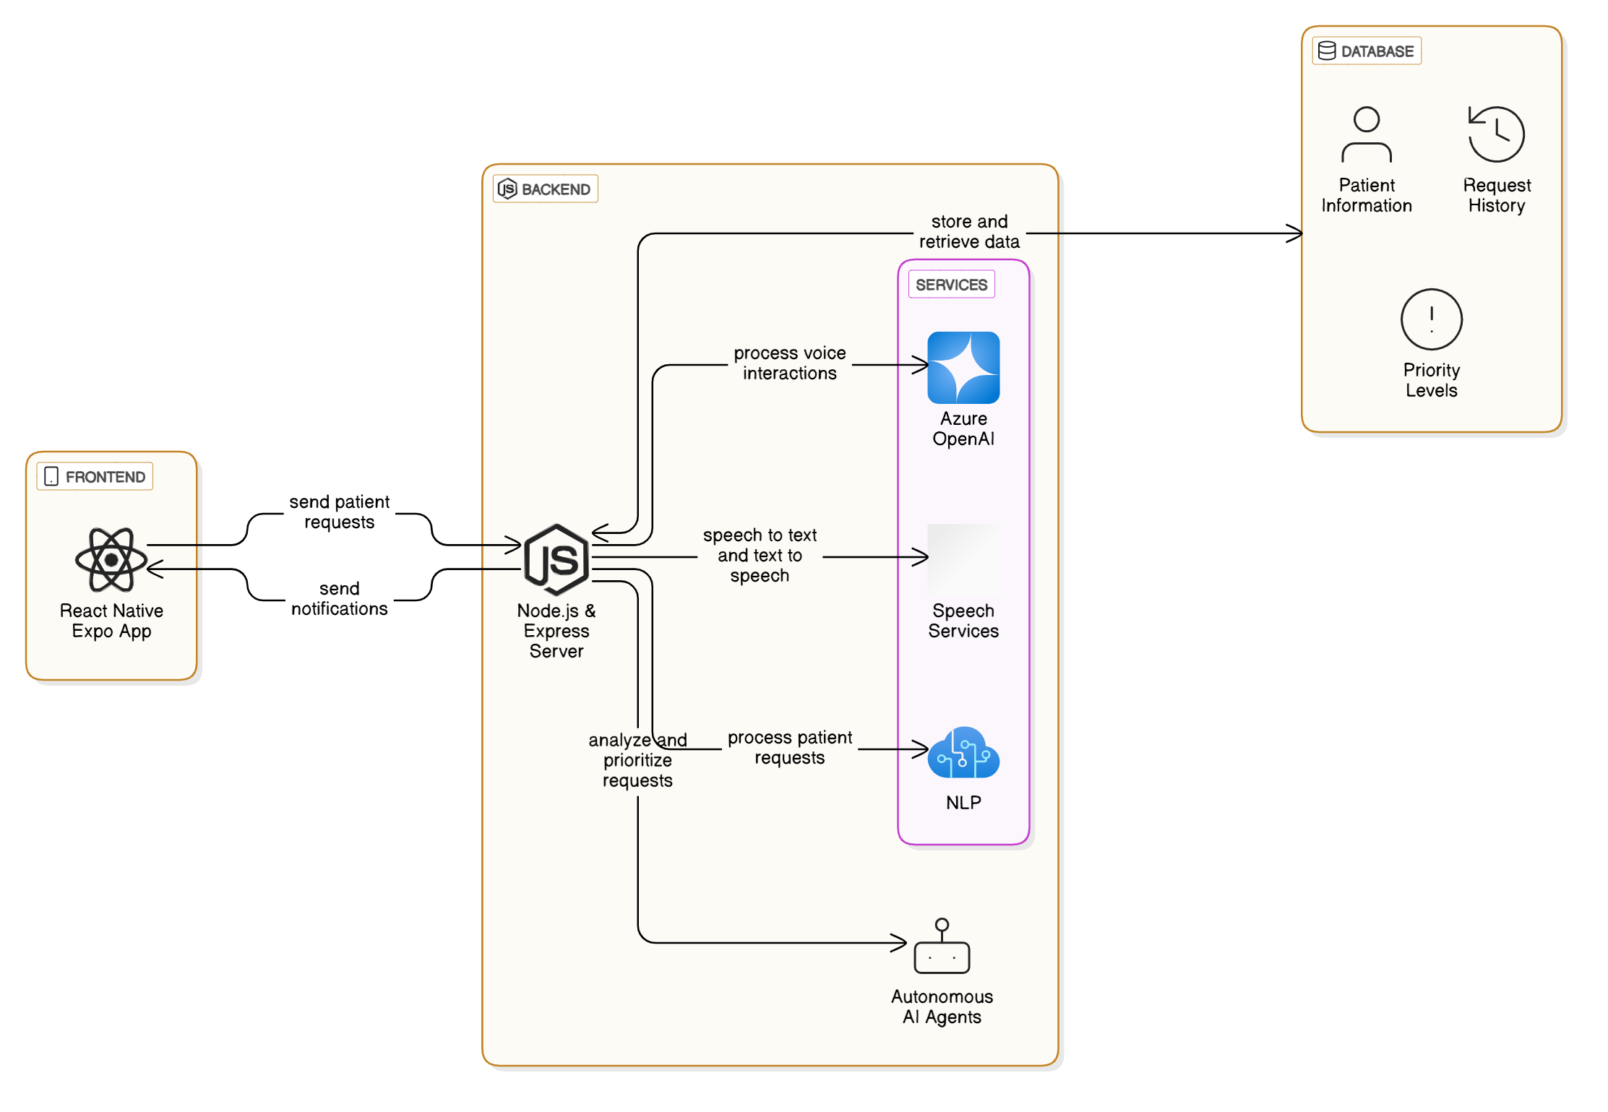
System Diagram

Slide 8
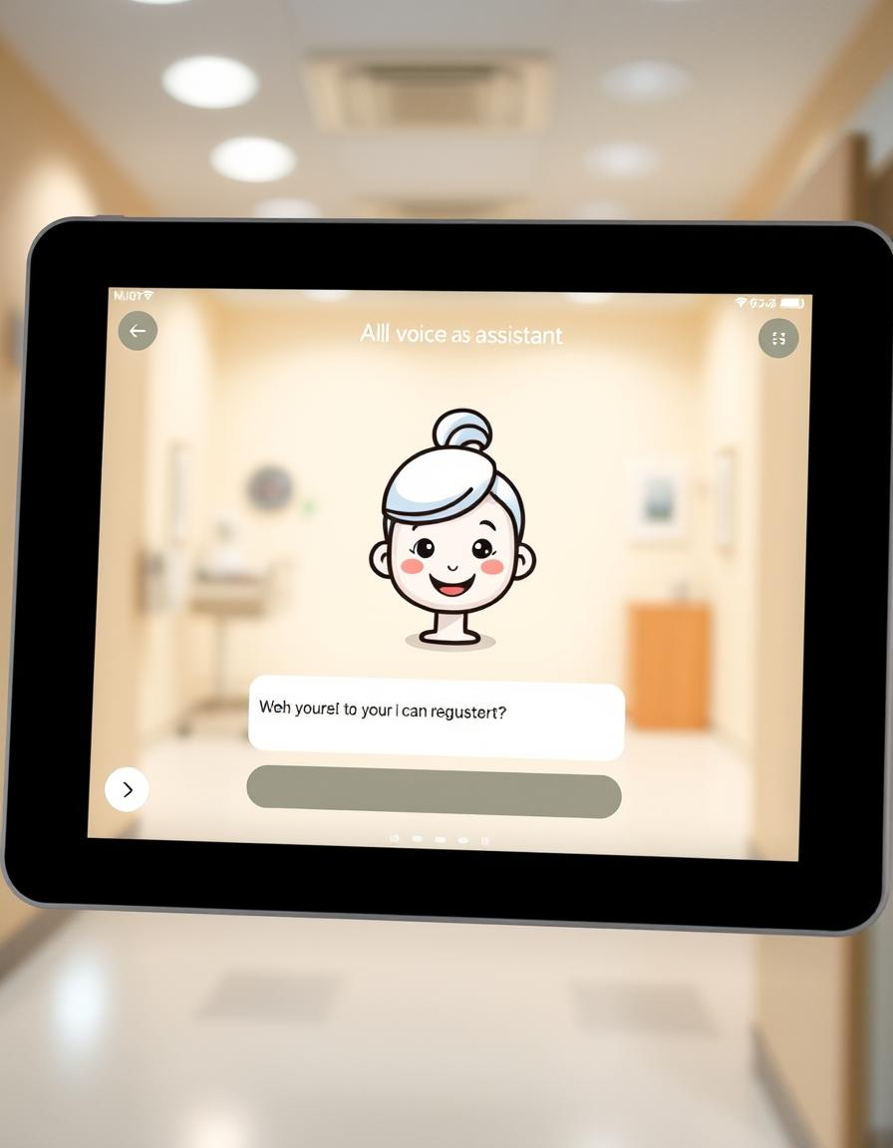
Key Features
1
Personalized Patient Experience
2
Request-Prioritization
AI classifies the requests as High, medium, low.
The system tailors interactions to each patient's needs.
3
Conversational AI Interface
4
Real-time Updates and Notifications
The system uses a natural language processing (NLP) engine to understand and respond to patient queries in a conversational manner.
Healthcare Staff receive notifications as soon as the request has been made by the Patient.

Slide 9
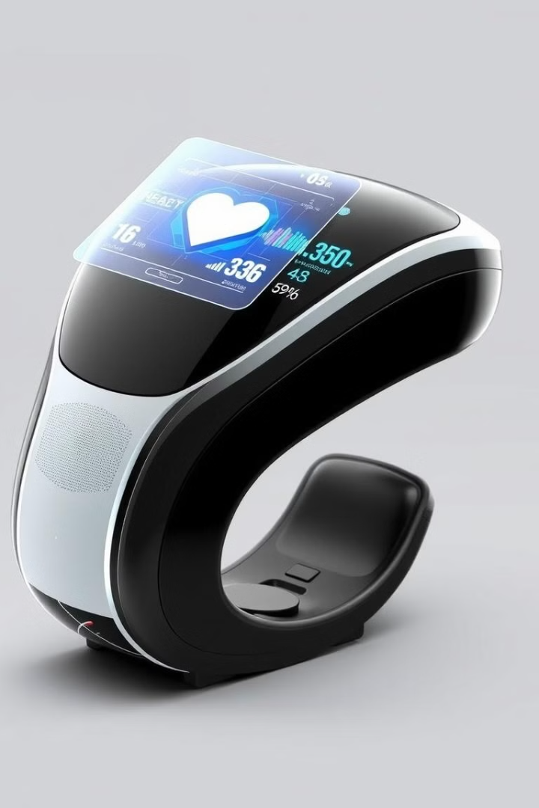
Future Scope and Roadmap
1
2
Integration with Wearables
Predictive Analytics
The system can be integrated with wearable devices to track patient health data in real-time.
The system can use patient data to predict potential health risks and recommend preventive measures.
3
4
Virtual Assistant for Chronic Conditions
IOT Devices Integration
The system can provide personalized support and guidance for patients with chronic conditions.
Connecting other healthcare devices to this app for more real-time monitoring.

Slide 10
THANK YOU

